Slide 1

Presentation on Structures of Operating System:
Student Name : Om Prakash Mahara
Level: M.Sc. Computer Science
Date : 01 falgun 2081
College : NCIT , Balkumari , Kathmandu.

Slide 2
OS structures:
The Operating System (OS) structure refers to the organization and design of an OS, which determines how different components interact to manage hardware and software resources efficiently.
Types of OS Structures
Monolithic Structure
Layered Structure
Microkernel Structure
Nanokernel Structure
Hybrid Structure
Exokernel Structure
Modular Structure
Process Management.
File Management.
Network Management.
Main Memory Management.
Secondary Storage Management.
I/O Device Management.
Security Management.
Command Interpreter System

Slide 3
1.Monolithic Kernel Structure :
Definition: A monolithic kernel is an operating system architecture where all essential services (such as process management, memory management, file system, and device drivers) run in kernel mode as a single program.
Key Characteristics
Single Large Process – The entire OS runs as one large program in kernel space.
High Performance – Since all components run in the same space, system calls are fast.
Direct Hardware Access – No message-passing overhead like in microkernels.
Difficult to Modify – Any change requires recompiling the entire kernel.
Less Secure & Less Stable – A crash in one module can crash the whole system.
Tightly Integrated Components – All OS functionalities (scheduling, memory, file system, drivers) are part of the kernel.

Slide 4
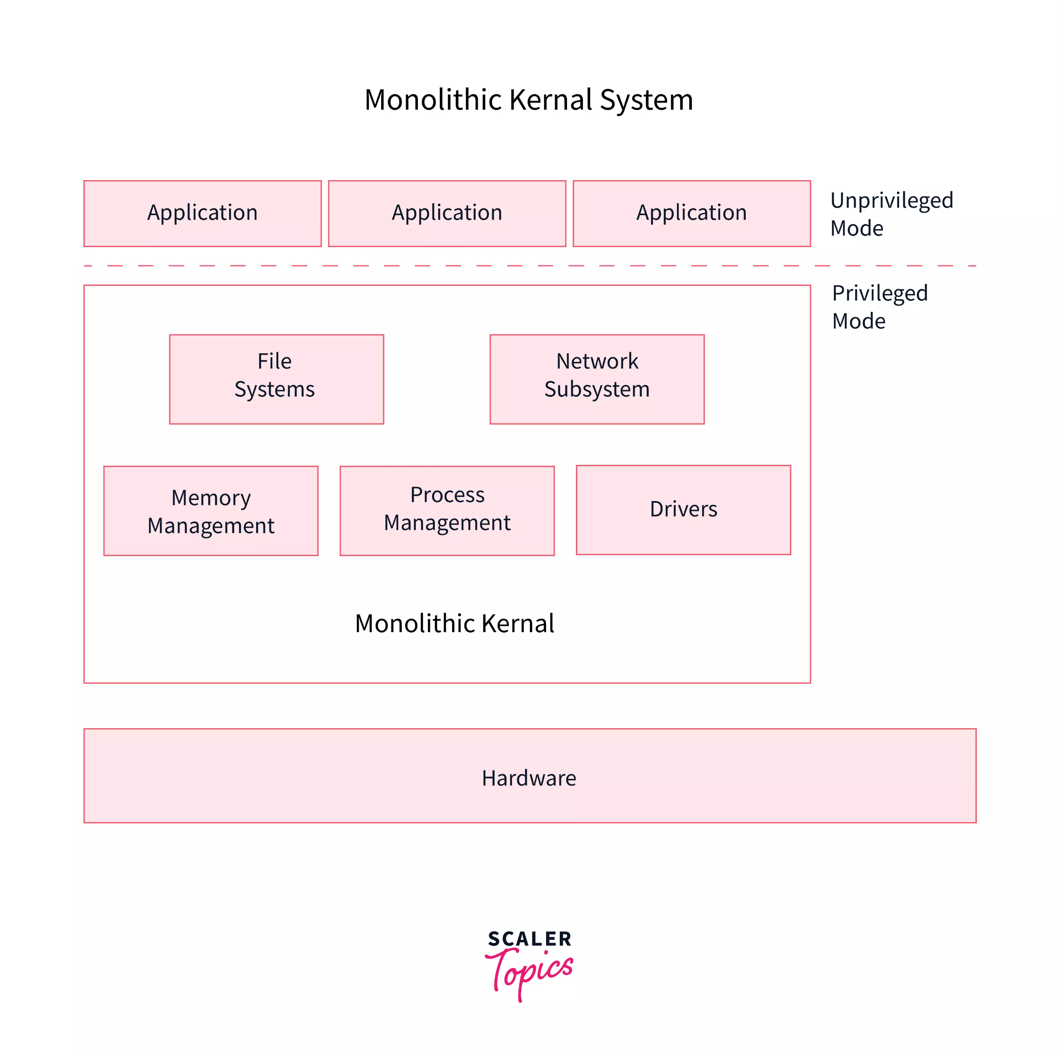

Slide 5
Monolithic OS:
Advantages:
Fast Execution – No user-kernel mode switching overhead.
Efficient Resource Management – Since everything runs in kernel mode.
Simple Design – No inter-process communication (IPC) complexity like microkernels.
Disadvantages:
Difficult to Maintain – Any bug or update requires modifying the entire kernel.
Less Secure – A bug in one part can compromise the entire system.
Not Modular – Adding or removing functionality is complex.
Examples of Monolithic Kernels:🔹 Linux Kernel🔹 Unix Kernel🔹 MS-DOS🔹 FreeBS

Slide 6
2.Layered Kernel Structure:
A layered kernel is an OS architecture that divides the operating system into multiple layers, where each layer performs specific functions and interacts only with adjacent layers.
Key Characteristics:
Hierarchical Structure – OS is divided into layers, each with well-defined functions.
Encapsulation – Lower layers provide services to upper layers, preventing direct access.
Modularity – Easier debugging and modification due to separation of concerns.
Abstraction – Each layer hides the details of lower layers, simplifying design.
Strict Communication – Layers communicate in a top-down or bottom-up manner.

Slide 7
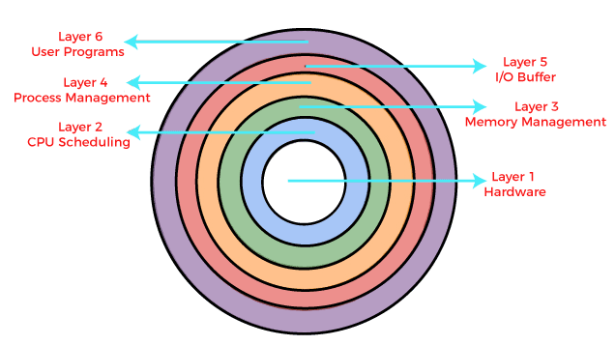
Layered Structure:

Slide 8
Layered OS:
Advantages:
Easier Maintenance – Each layer can be modified independently.
Better Security & Stability – A failure in one layer does not affect others.
Well-Organized System – Clear separation of functions improves OS design.
Disadvantages:
Performance Overhead – Increased latency due to layer-by-layer communication.
Complex Design – Designing proper layer interactions is challenging.
Rigid Structure – Strict layer dependencies may limit flexibility.
Examples of Layered Kernels:🔹 THE OS (First layered OS)🔹 Multics🔹 Windows NT (partially layered)🔹 UNIX (Some versions)

Slide 9
3.Micro Kernel OS:
A microkernel is an OS architecture where only the essential core functions (such as process management, memory management, and inter-process communication) run in kernel mode, while other services (like device drivers, file systems, and networking) run in user mode.
Key Characteristics:
Minimalist Design – Only essential services run in the kernel space.
User-Space Services – Most OS functionalities operate in user mode.
Modular & Extensible – Easier to modify and update compared to monolithic kernels.
Inter-Process Communication (IPC) – Components communicate via message passing.
Enhanced Security & Stability – A failure in one service doesn’t crash the entire system.

Slide 10
Micro Kernel OS:

Slide 11
Micro Kernel OS:
Advantages:
Better Stability – A faulty driver or service won’t crash the whole OS.
Improved Security – Less code in kernel space reduces attack risks.
Easier Maintenance & Updates – Services can be updated independently.
Supports Distributed Systems – Can efficiently run on multiple CPUs.
Disadvantages:
Performance Overhead – IPC and frequent user-kernel mode switches slow down execution.
Complex Design – Requires careful handling of message passing and process synchronization.
Driver and Service Compatibility Issues – Requires well-designed user-space components.
Examples of Microkernel-Based OS:🔹 QNX (used in embedded systems)🔹 MINIX (used in education and research)🔹 L4 Microkernel (used in real-time systems)🔹 macOS (XNU Kernel - hybrid microkernel)

Slide 12
4.Hybrid Kernel OS:
A hybrid kernel is an OS architecture that combines the benefits of both monolithic and microkernel designs. It runs core services in kernel mode (like a monolithic kernel) but uses user-space modules for flexibility (like a microkernel).
Key Characteristics:
Combination of Monolithic & Microkernel Features – Balances performance and modularity.
Faster than Microkernel – Reduces IPC overhead by running some services in kernel space.
More Modular than Monolithic Kernel – Some OS components run in user space.
Better Security & Stability – Faulty services can be restarted without crashing the entire OS.
Efficient Performance – Avoids excessive user-kernel switching delays.

Slide 13
Hybrid Kernel OS:
Advantages:
Improved Performance – Faster than microkernels due to fewer IPC calls.
Better Stability than Monolithic Kernels – Faulty drivers can be isolated.
Modular and Scalable – Easier to modify or add new functionalities.
Enhanced Security – Critical services can be protected in user space.
Disadvantages:
More Complex than Monolithic Kernels – Hybrid design adds development complexity.
Still Has Some Kernel Bloat – May not be as lightweight as a pure microkernel.
Performance Trade-Offs – Balancing kernel/user space operations can be tricky.
Examples of Hybrid Kernel-Based OS:🔹 Windows NT, XP, 7, 10, 11 (uses a hybrid kernel approach)🔹 macOS (XNU Kernel) (combines microkernel and monolithic elements)🔹 BeOS (optimized for multimedia applications)🔹 IBM OS/2

Slide 14
5.Exokernel OS:
An Exokernel is an OS architecture that provides direct, low-level access to hardware resources, allowing applications to manage resources independently without OS intervention. Unlike traditional kernels, it avoids abstraction and only enforces protection and multiplexing policies.
Key Characteristics:
Minimalist Design – The OS kernel is very small and only enforces security and resource allocation.
Direct Hardware Access – Applications can directly interact with hardware.
User-Level Resource Management – Applications handle their own memory, CPU scheduling, and I/O.
Highly Efficient – Eliminates unnecessary OS overhead, leading to faster execution.
Security Enforcement – The kernel only ensures that applications don’t interfere with each other.

Slide 15
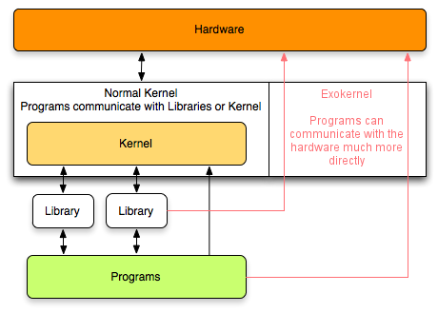
Exo kernel OS:

Slide 16
Exokernel OS:
Advantages:
Maximum Performance – No system call overhead, allowing high-speed execution.
Customizability – Applications can define their own resource management policies.
Efficient Resource Utilization – No predefined OS-level abstractions, giving full control to users.
Flexibility – Suitable for specialized applications that need direct hardware access.
Disadvantages:
Complex Application Development – Developers must manually manage hardware resources.
Security Challenges – Giving applications direct access to hardware increases risks.
Limited Adoption – Not widely used due to its complexity and niche use cases.
Examples of Exokernel-Based Systems:🔹 ExOS (MIT's experimental OS)🔹 Nemesis OS (designed for multimedia applications)

Slide 17
6.Nano Kernal OS:
Definition:A Nano Kernel is an OS architecture that further minimizes the microkernel approach by only handling basic hardware interactions (such as CPU switching and basic messaging), while all other OS functions run in user space.
Key Characteristics:
Smaller than Microkernels – Only manages CPU, interrupts, and minimal scheduling.
Most OS Services in User Space – File systems, memory management, and networking run outside the kernel.
Extremely Lightweight – Designed for high-performance, real-time, and embedded systems.
Supports Multiple OS Instances – Can run different OS environments on the same hardware.
Fast and Secure – Limited kernel functionality reduces attack surfaces.

Slide 18
Nano Kernel OS:
Advantages:
Highly Modular – Easy to extend and update.
Increased Security – Less kernel code reduces vulnerability risks.
Real-Time Performance – Ideal for embedded and real-time systems.
More Stable than Monolithic Kernels – Faulty services do not crash the kernel.
Disadvantages:
High Communication Overhead – More IPC calls between user-space components.
Complex System Design – Requires well-structured user-space services.
Limited General-Purpose Use – Mostly used in specialized environments.
Examples of Nano Kernel-Based Systems:🔹 L4 Microkernel (some versions started as a nano kernel)🔹 Embedded & IoT systems (certain real-time OS implementations

Slide 19
7.Modular Kernel OS:
Definition: A Modular Kernel is an OS architecture that allows dynamically loadable kernel modules, enabling the kernel to be extended without requiring a full reboot or recompilation. It is a hybrid approach between monolithic and microkernels. This is the most currently used approach to operating systems
Key Characteristics:
Dynamically Loadable Modules – Kernel functionalities (drivers, file systems, networking) can be added or removed as needed.
Better than Monolithic Kernels – Provides flexibility without sacrificing performance.
More Efficient than Microkernels – Reduces IPC overhead by keeping critical components in kernel space.
Extensible and Scalable – New functionalities can be added at runtime.
Improved Maintainability – Bugs can be fixed without recompiling the entire kernel.

Slide 20
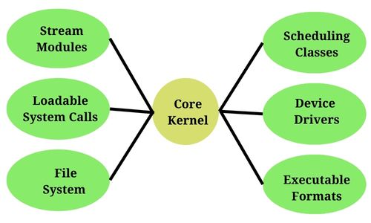
Modular OS:

Slide 21
Modular Kernel OS:
Advantages:
High Performance – Core functions remain in kernel space, reducing overhead.
Flexibility & Customization – Modules can be loaded or unloaded dynamically.
Improved Stability – Faulty modules can be removed without affecting the whole OS.
Easy to Update – Drivers and features can be updated without modifying the kernel.
Disadvantages:
Security Risks – Malicious or buggy modules can compromise the kernel.
More Complexity – Requires careful module management to avoid system crashes.
Compatibility Issues – Some modules may not work well with others.
Examples of Modular Kernel-Based OS:🔹 Linux Kernel (supports loadable kernel modules - LKM)🔹 Windows NT Kernel (modular hybrid architecture)🔹 IBM AIX

Slide 22

THANK YOU

